Slide 1
A short Story about Rostov-on-Don
Creator: Arina Peltek, 6«B»
Teacher: G.I. Gladyreva

Slide 2
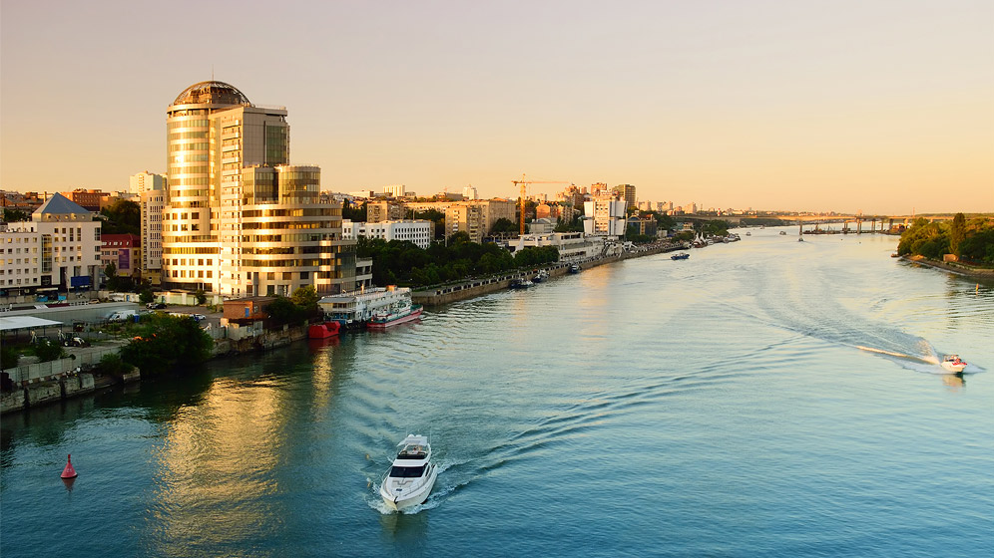
Rostov-on-Don
My native city is Rostov-on-Don. It is the capital of the Don area. It was founded in 1749. It is situated on the right bank of the river Don.
In the past Rostov was a small town. But now the territory of Rostov-on-Don is 380 square kilometres and the population is more than one million people.

Slide 3
Progressive Rostov-on-Don
Our city is a big industrial, scientific and cultural centre in the South of Russia. The plant “Rostselmash” is known through its agricultural machines not only in our country but abroad as well.
The largest scientific and educational establishment is the Rostov State University, which was founded in 1915 and now has many faculties – institutes because its name is Southern Federal University.

Slide 4
Theatrical Side
In Rostov there are four theatres: Gorky Drama Theatre, Musical Theatre, Puppet Theatre, Youth Theatre. The Gorky Theatre is surrounded by a large October Revolution park. It is one of many parks and gardens which make Rostov a green town and where Rostovites like to walk on a nice sunny day in every season.

Slide 5
Final part
During the Second World War Rostov-on-Don was occupied twice (1941 and 1942). The war cost Rostovites huge losses in life. That is why in the city there are a lot of monuments devoted to the war years and people who gave their lives for peace. We are very thankful for that!
Rostov-on-Don is a large transport centre. It is not only a big knot of railways and airways but it is also the port of five seas (the Baltic, the White, the Caspian, the Black and the Sea of Asov).
Nowadays Rostov-on-Don is overpassing all the difficulties and will certainly occupy its place of one of the biggest industrial cities of Russia.
I love my city!

Slide 6
Rostov-on-Don

Slide 7
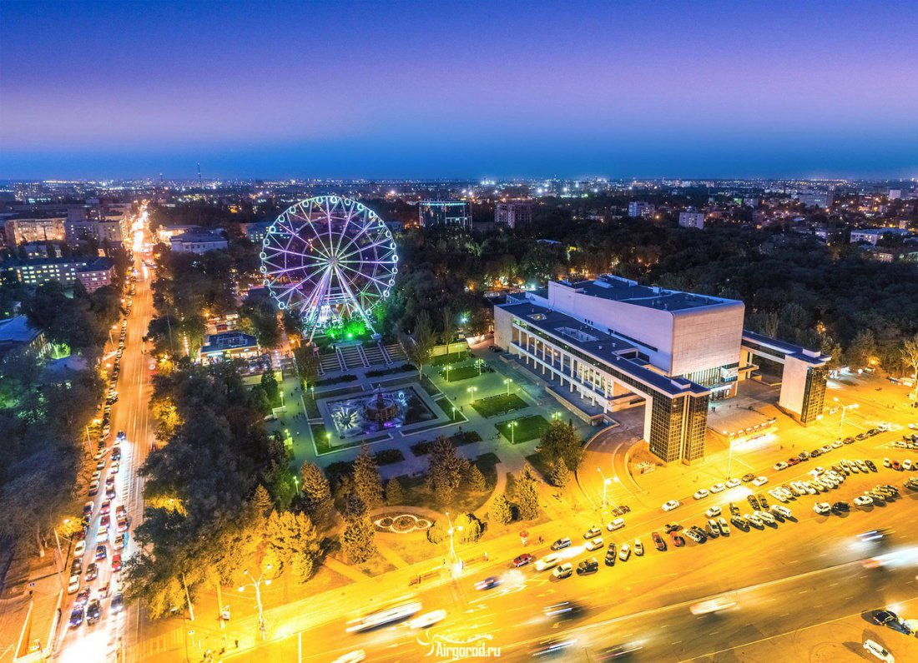
Rostov’s main sights

